Slide 1


BASIC ELECTRONICS AND ELECTRICAL ENGINEERING
BY- CHANDANA MN (CSE-087)
mchandanaBTECH20@ced.alliance.edu.in
HARSHITHA MASUR(AE-016)
harshithaBTECH20@ced.alliance.edu.in
PRIYANKA HANSDA(AE-009)
priyankaBTECH20@ced.alliance.edu.in
guided BY- Dr.HARINATH AIREDDY​

Slide 2



AUTOMATIC LIGHT INTENSITY CONTROL

Slide 3
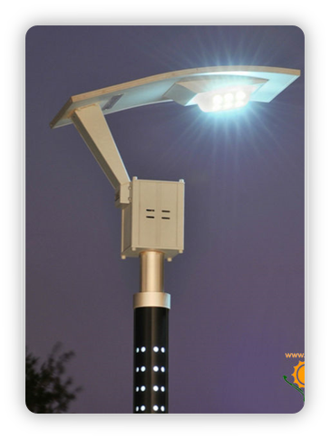
WHAT IS INTENSITY AUTOMATIC CONTROL?
THIS IS AN INNOVATIVE ENERGY SAVING SYSTEM THAT AUTOMATICALLY ADJUSTS LIGHT INTENSITY BASED ON EXTERNAL LIGHT SENSING

Slide 4

BROAD THRUST AREA:
Artificial intelligence and machine learning
Automation

Slide 5
Abstract:
This project aims at designing and executing the advanced development in embedded systems for energy saving of street lights.
Nowadays, human has become too busy, and is unable to find time even to switch the lights wherever not necessary. The present system is like, the street lights will be switched on in the evening before the sun sets and they are switched off the next day morning after there is sufficient light on the roads.
this project gives the best solution for electrical power wastage. Also the manual operation of the lighting system can be completely eliminated.

Slide 6

Cont.
In this project , two sensors are used which are Light Dependent Resistor LDR sensor to indicate a day/night time and the photoelectric sensors to detect the movement on the street. the microcontroller is used as brain to control the street light system.

Slide 7
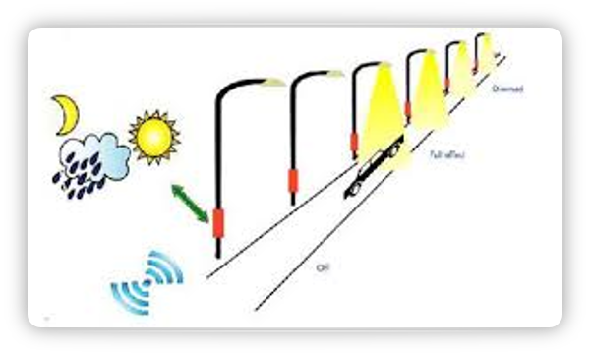
AUTOMATED CONTROL
Lighting control systems typically provide the ability to automatically adjust a lighting device's output based on:
Chronological time (time of day)
Solar time (sunrise/sunset)
Occupancy using occupancy sensors
Daylight availability using photocells
Alarm conditions
Program logic (combination of events)

Slide 8
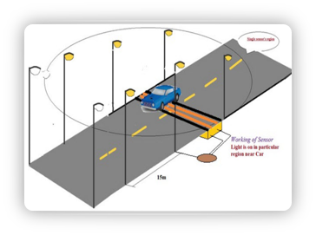
AUTO INTENSITY CONTROL OF STREET LIGHTS :
Basic purpose of this project is to make street lights intelligent so that it can turn it on and off itself. Another feature of this project is that street lights intensity vary according to intensity of light and number of vehicles on road. Followings are the main features of this project :
Street lights turns itself on automatically during night or darkness. They turn themself off automatically during day time and during visible intensity of light.

Slide 9
CONT.
Street lights controls its intensity automatically according to intensity of light. For example in evening intensity of light start decreasing at the same time street lights start increasing its intensity. When there is no intensity of light in after evening, street lights turn themself on with full intensity till midnight at 12:00 am.
There is another feature included in this project that is vehicle detection. Infrared\photoelectric sensor circuit is used to detect vehicles on road. After 12:00am street lights start decreasing their intensity. At 1:00am street lights turn off automatically. After 1:00 am function of vehicle detection starts. If there is any vehicle on road after 1:00am, street lights turns on for 2 minutes. After that they turn off automatically. In other words, After 1:00am street lights turn on only if there is any vehicle on road. Otherwise they remain off. This process remains till morning. But after having visible intensity of light during moring street lights turn off automatically.

Slide 10
Main COMPONENTS USED IN our project:
LDR
Photoelectric sensor
Power supply[KA8705 voltage regulator IC]
Relays
Micro controller
Connecting Wires
Breadboard
LED.

Slide 11
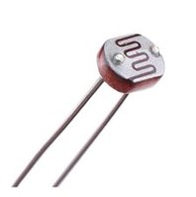
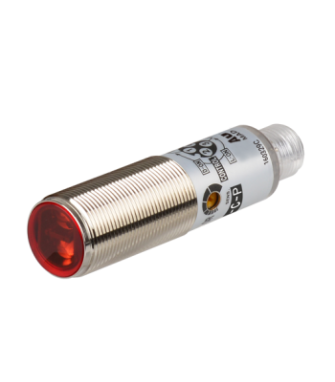
SPECIFICATION OF COMPONENTS
LDR: The LDR is a resistor and its resistance varies according to the amount of light falling on its surface. When the LDR detect light its resistance will get decreased, thus if it detects darkness its resistance will increase.
Photoelectric Sensor: To detect the movement in the street, the photoelectric sensors have been used.where emitter and receiver are in one unit.Light from the emitter strikes the target and the reflected light is diffused from the surface at all angles. If the receiver receives enough reflected light the output will switch states. When no light is reflected back to the receiver the output returns to its original state.
OR IN SHORT; A photoelectric sensor is a device that detects a difference in the light level received from the light source. The sensor is made up of a light source, an amplifier, signal converter, and an output.

Slide 12
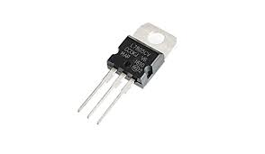
CONT.
3.Regulated Power Supply: A regulated power supply converts unregulated AC to a constant DC . A regulated power supply is used to ensure that the output remains constant even if the input changes.
In specific:
a 5V Voltage Regulator that restricts the output voltage to 5V output for various ranges of input voltage. It acts as an excellent component against input voltage fluctuations for circuits, and adds an additional safety to the circuitry.

Slide 13
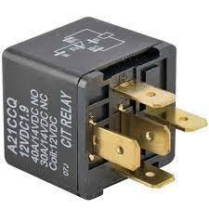

Cont.
4.Relays: Relays are remote control electrical switches that are controlled by another switch, such as a horn switch or a computer as in a power train control module. Relays allow a small current flow circuit to control a higher current circuit. Several designs of relays are in use today, 3-pin, 4-pin, 5-pin, and 6- pin, single switch or dual switches. Relays which come in various sizes, ratings, and applications, are used as remote control switches.
5. LED: A light-emitting diode .a semiconductor diode which glows when a voltage is applied.

Slide 14
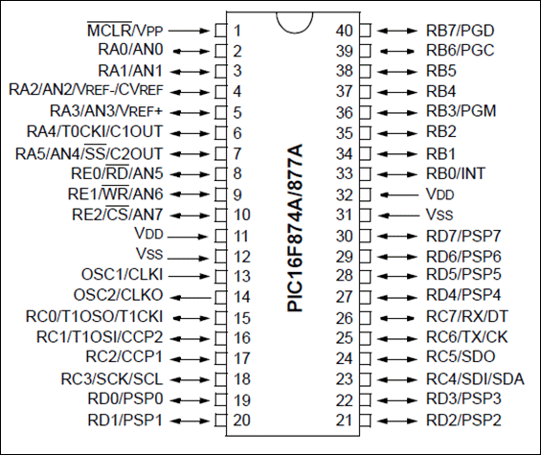

Cont.
6.Microcontroller: A microcontroller is a computer control system on a single chip. It has many electronic circuits built into it, which can decode written instructions and convert them to electrical signals. The microcontroller will then step through these instructions and execute them one by one.
7. breadboard: A breadboard or protoboard, is a construction base for prototyping of electronics.

Slide 15
BLOCK DIAGRAM
POWER SUPPLY
LDR
MICROCONTROLLER
PHOTOELECTRIC SENSOR
RELAY
STREET LIGHT

Slide 16
BUDGET
LDR -Rs.29
PHOTOELECTRIC SENSOR[220V] -around Rs. 168
RELAY[3pin] -Rs.135
MICROCONTROLLER[PIC16F877A] -Rs.127
REGULATED POWER SUPPLY[KA8705 voltage regulator IC] -Rs.10-15
Wires(1 pac) -Rs.30
400 point bread board -Rs.65
Single LED -Rs.10
TOTAL =Rs.579
So the estimated cost of our project is Rs.579

Slide 17
AUTO INTENSITY CONTROL OF STREET LIGHTS CIRCUIT ADVANTAGES
Power wastage can be reduced.
Reduces the cost.
produces accurate results.

Slide 18

ADVANTAGES OF AUTO INTENSITY CONTROL OF STREET LIGHTS :
No need to control street lights manually.
Electrical power saving.
Increases life time of street lights.
Intelligent street lights.
Vehicle detection.

Slide 19
Existing product
This project is still under research .
There are only proto types avilable.
There is no proper fully developed product whis is being in use.

Slide 20
Order details of the components

Slide 21
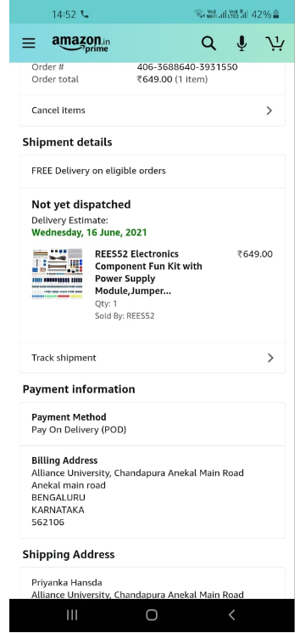

Slide 22
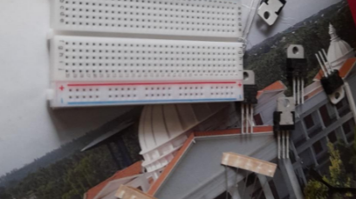
Components collected

Slide 23

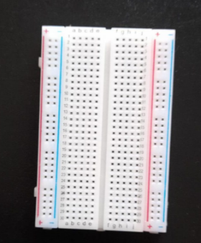
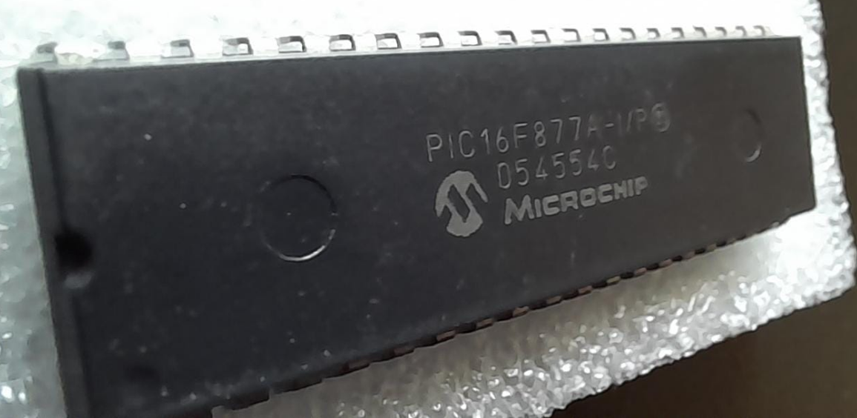
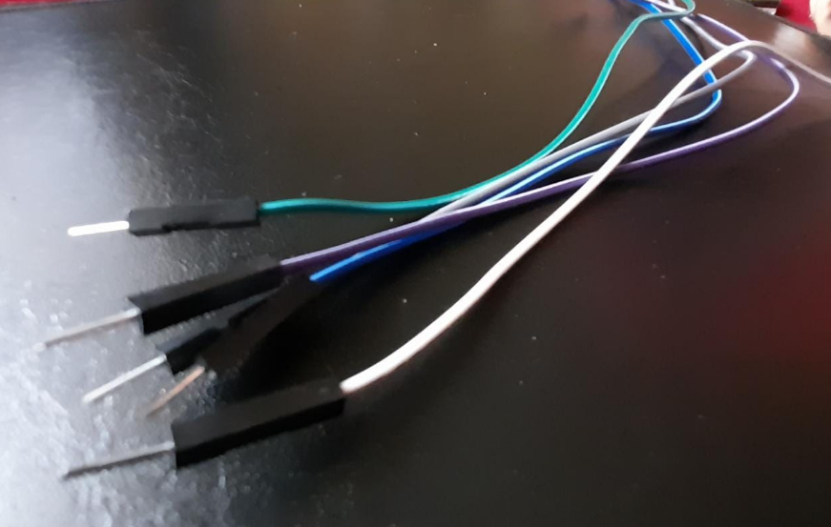
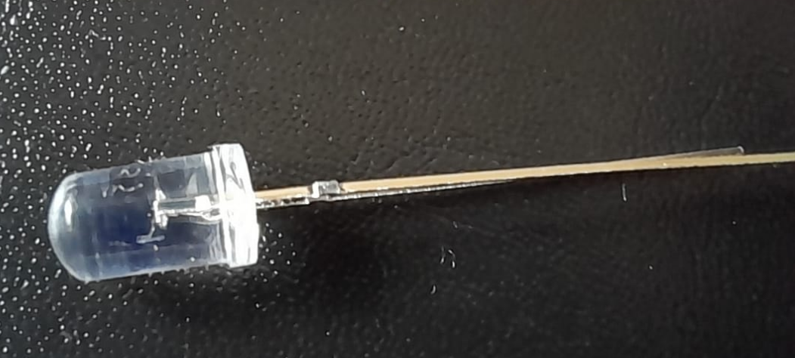
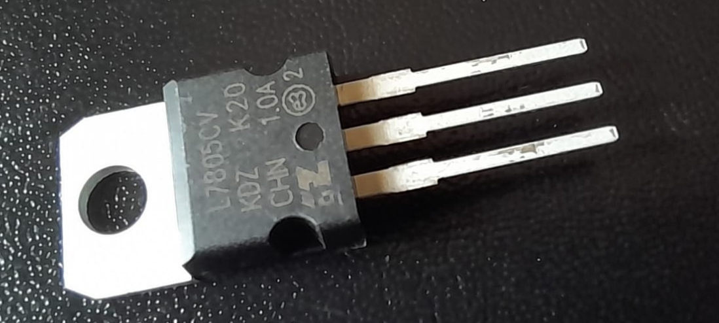

Slide 24
reference
Case Study of Hybrid Wind-Solar Power Systems for Street Lighting
S. Georges ECCE Department Notre Dame University - Louiaze Zouk Mosbih, Lebanon sgeorges@ndu.edu.lb
F. H. Slaoui Unité d'enseignement en sciences appliquées Université du Québec en Abitibi-Témiscamingue Rouyn-Noranda , Canada fouad.slaoui hasnaoui@uqat.ca

Slide 25
Project building

Slide 26
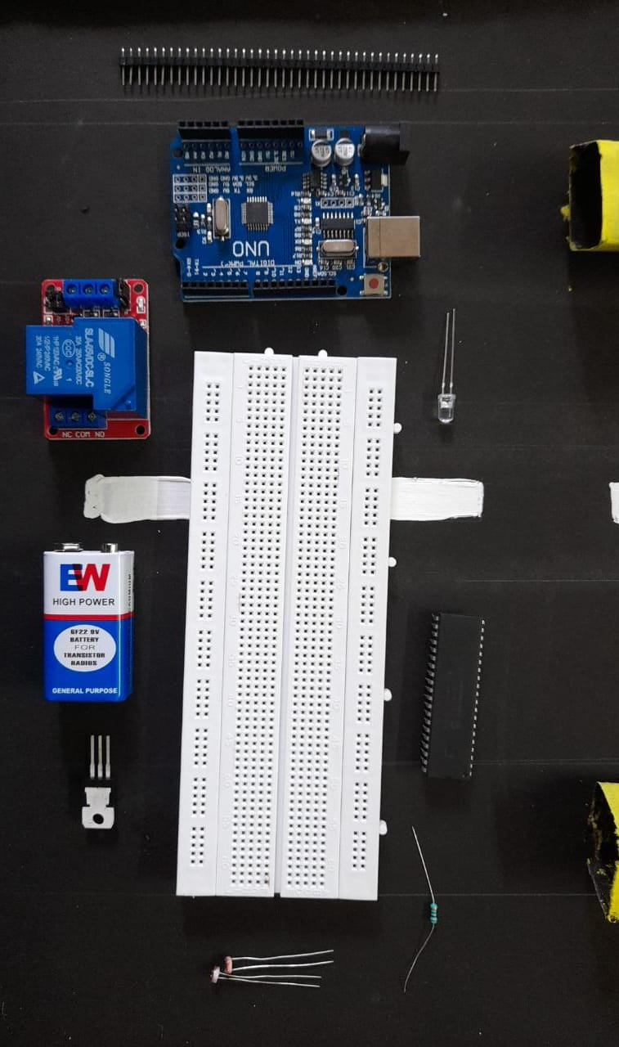
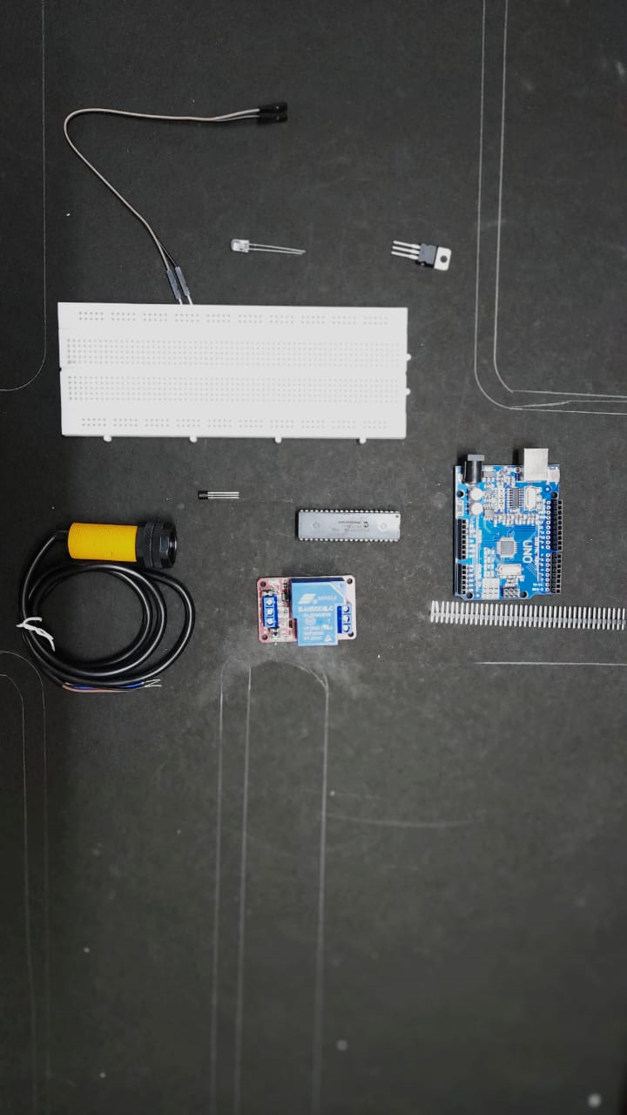
Step :1

Slide 27
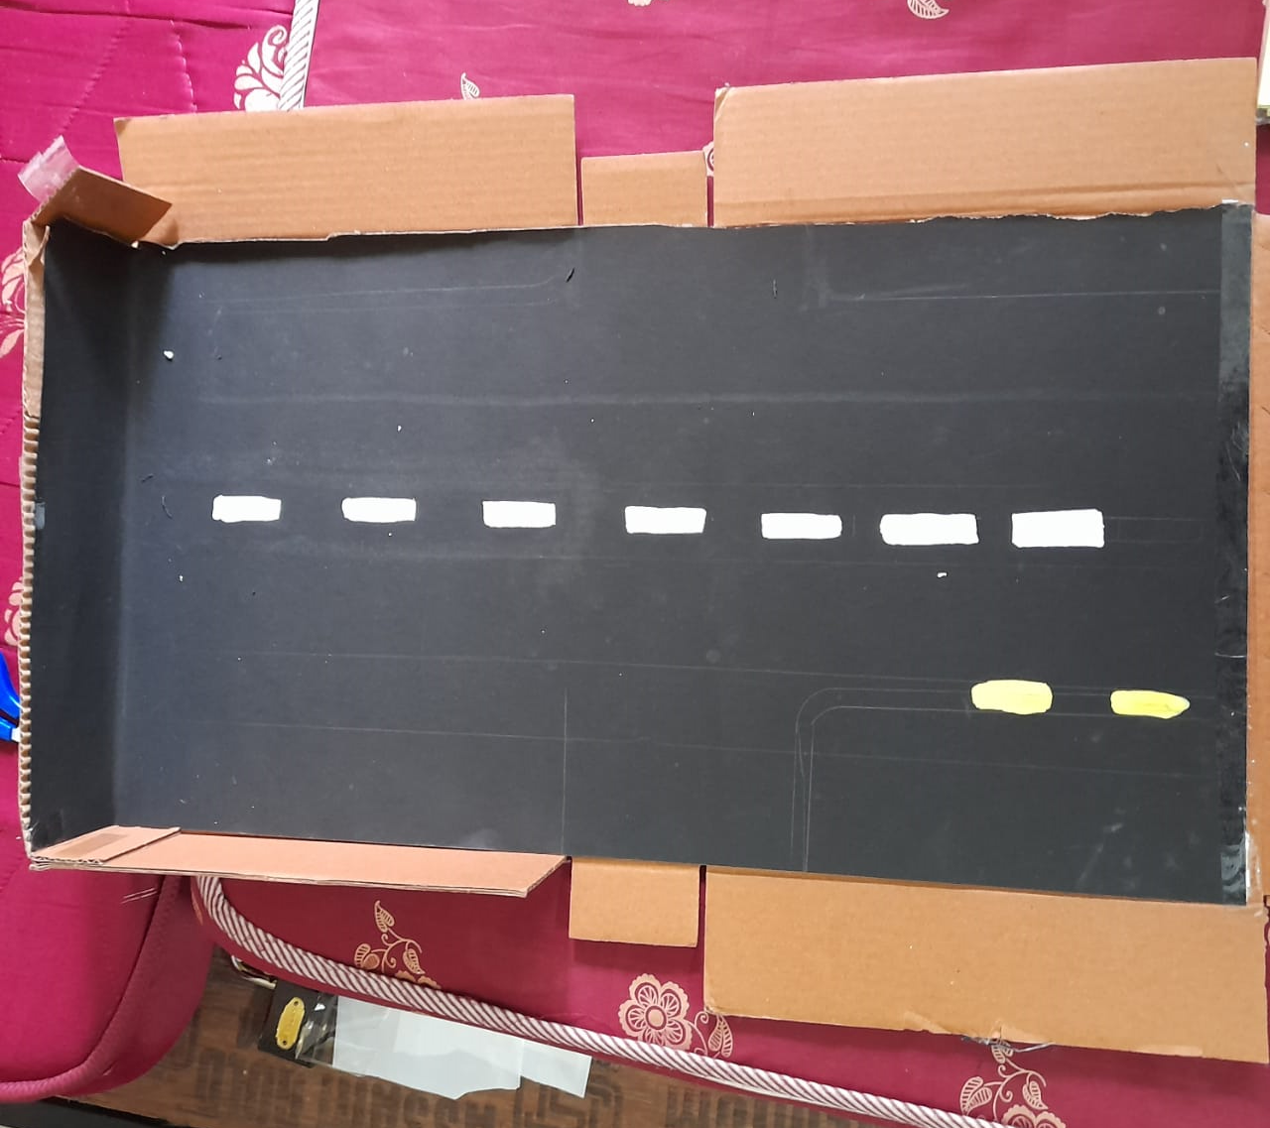
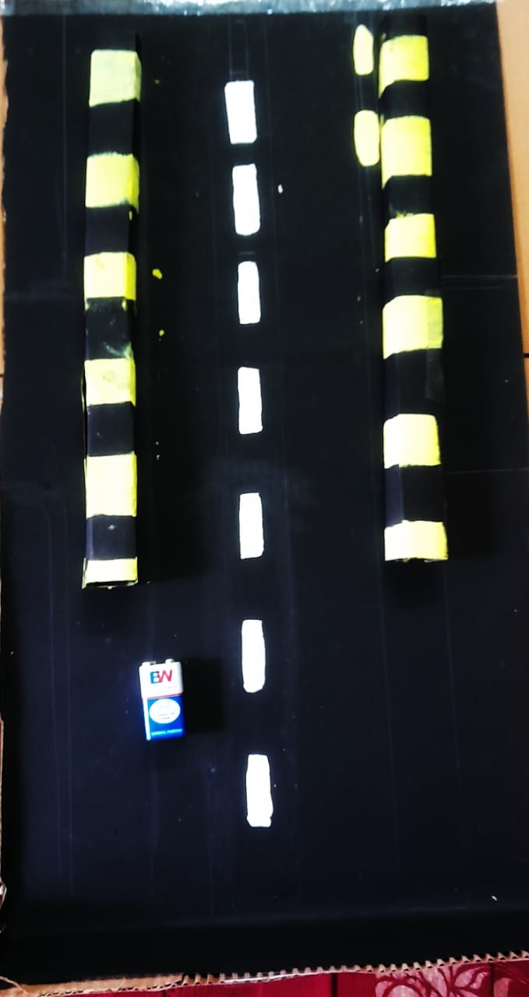
Step:2

Slide 28
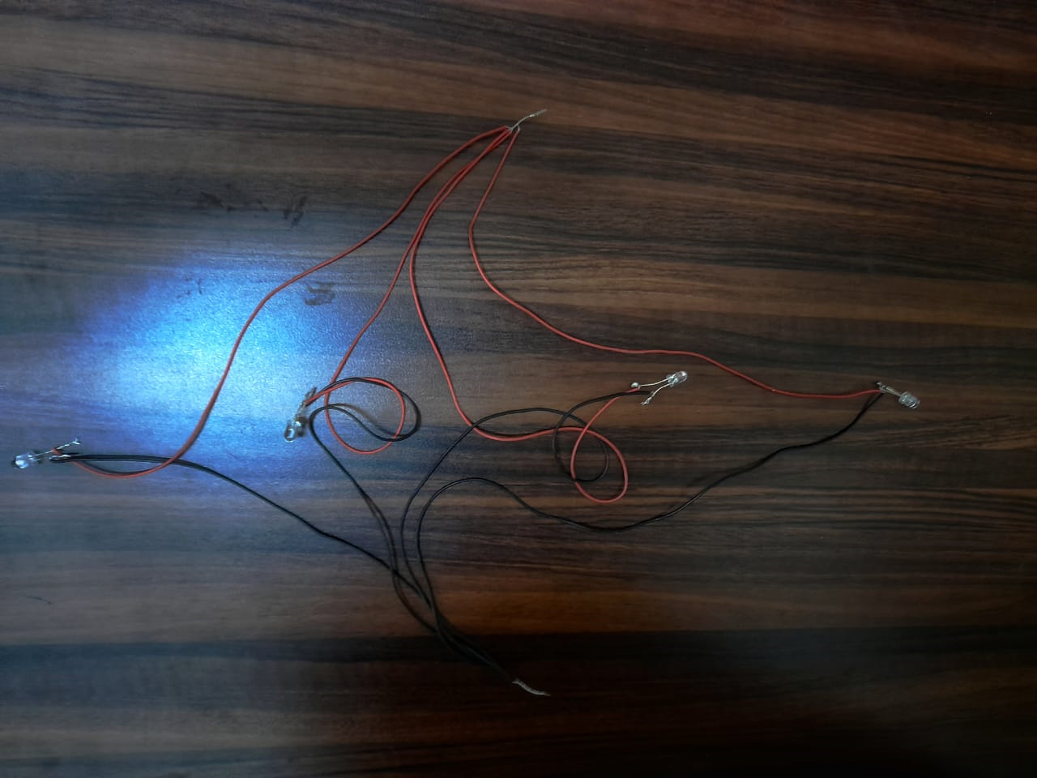
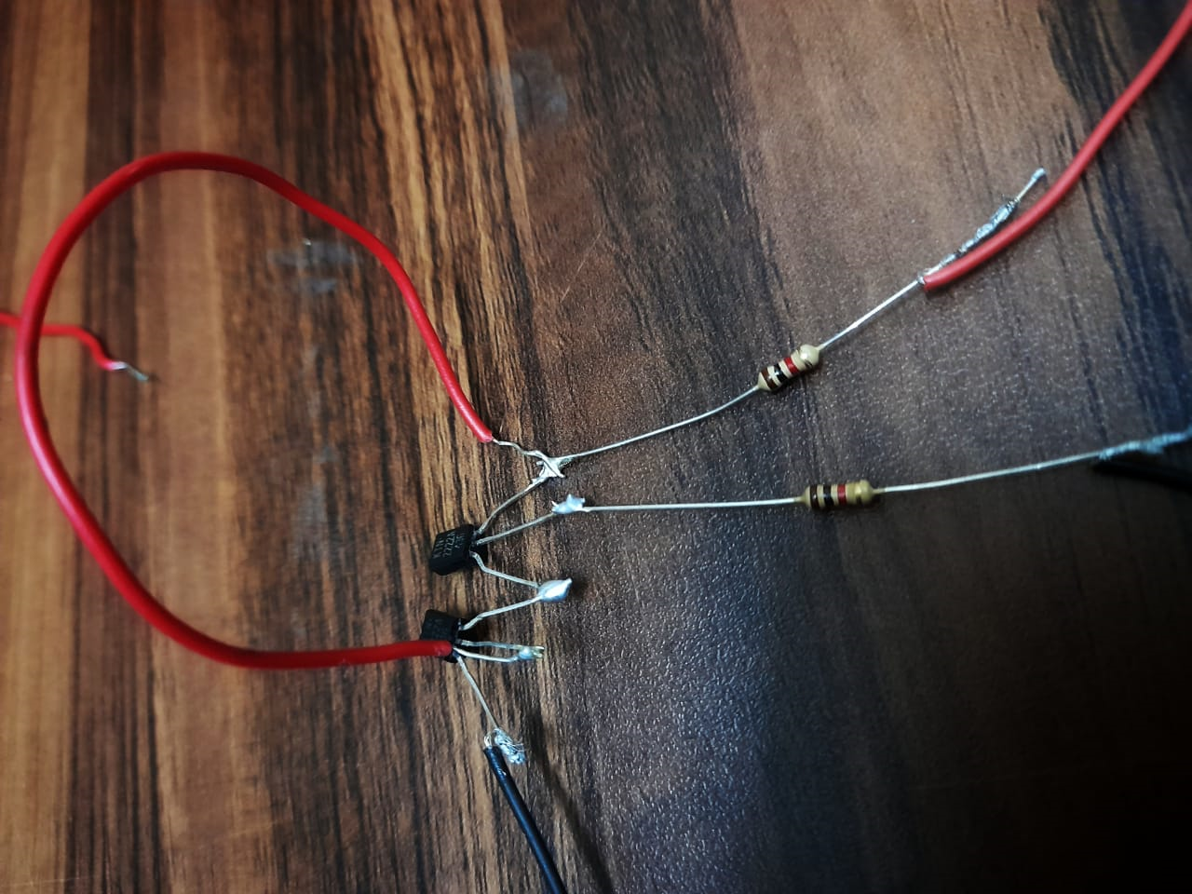
Step :3

Slide 29
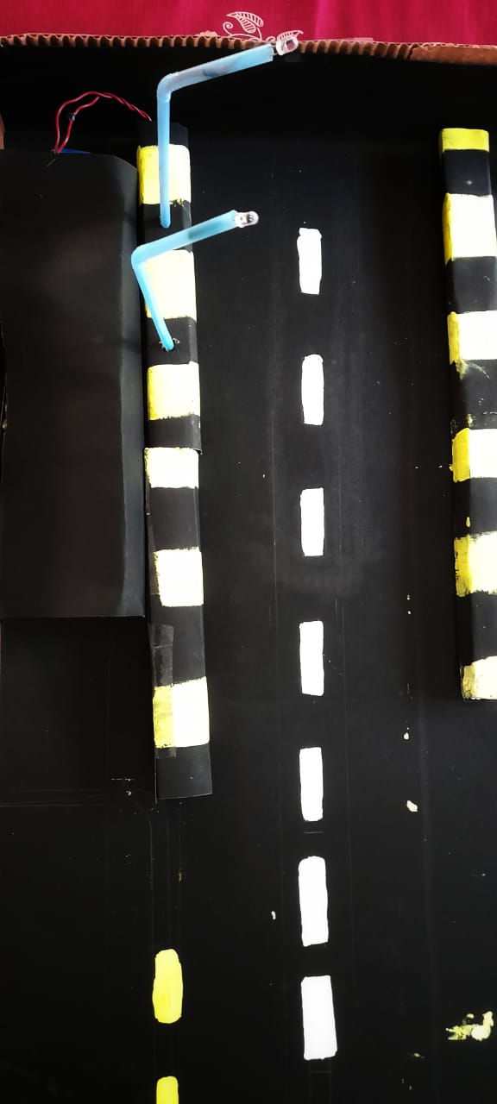
Step :4

Slide 30
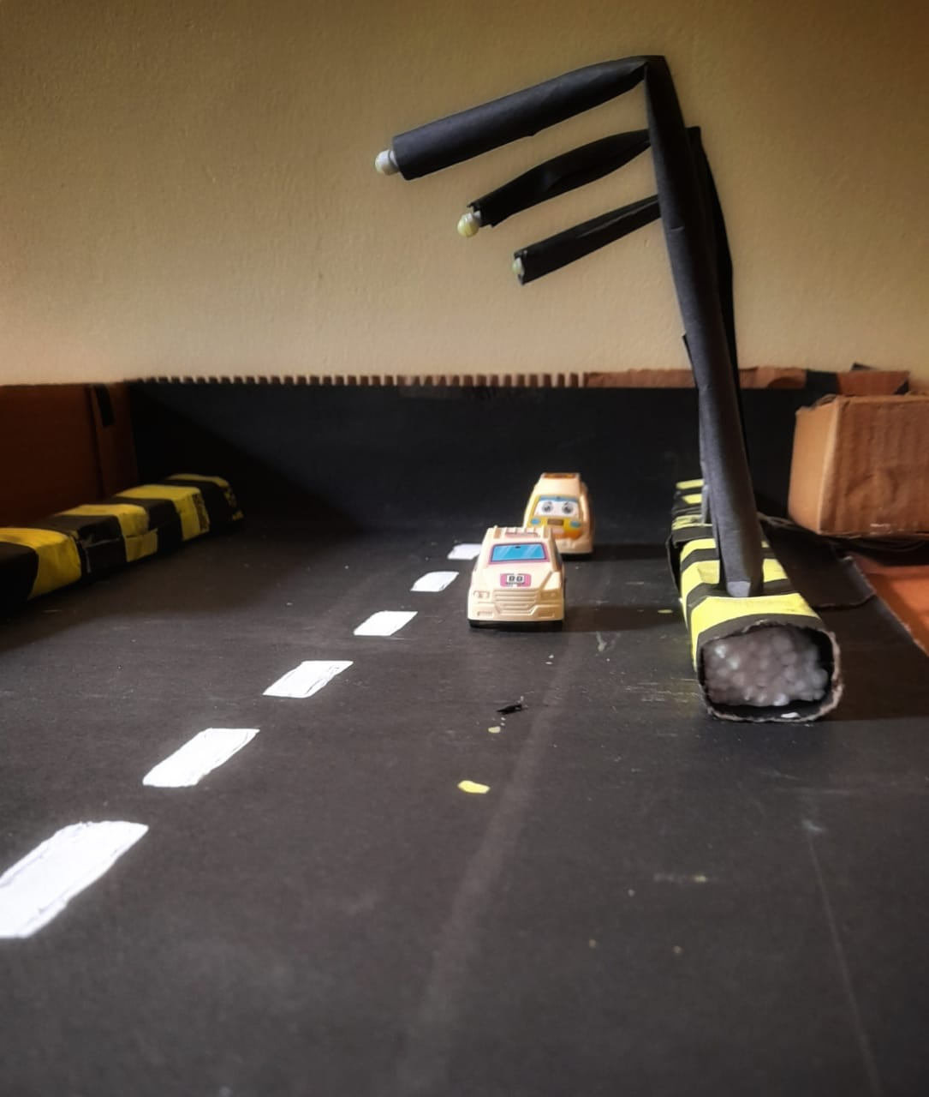
Step :5

Slide 31
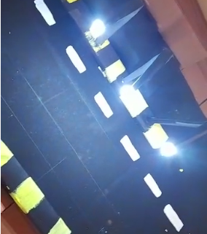
Final result of our project

Slide 32
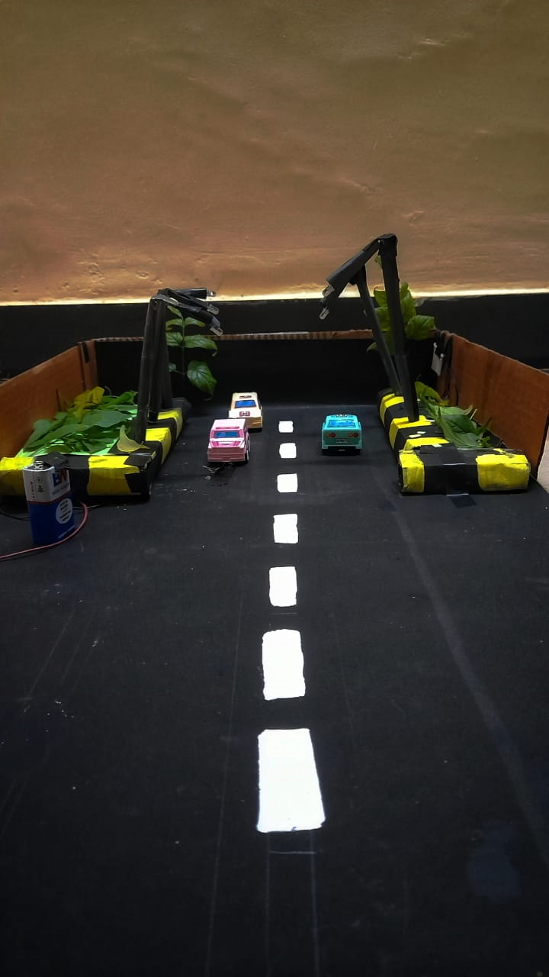
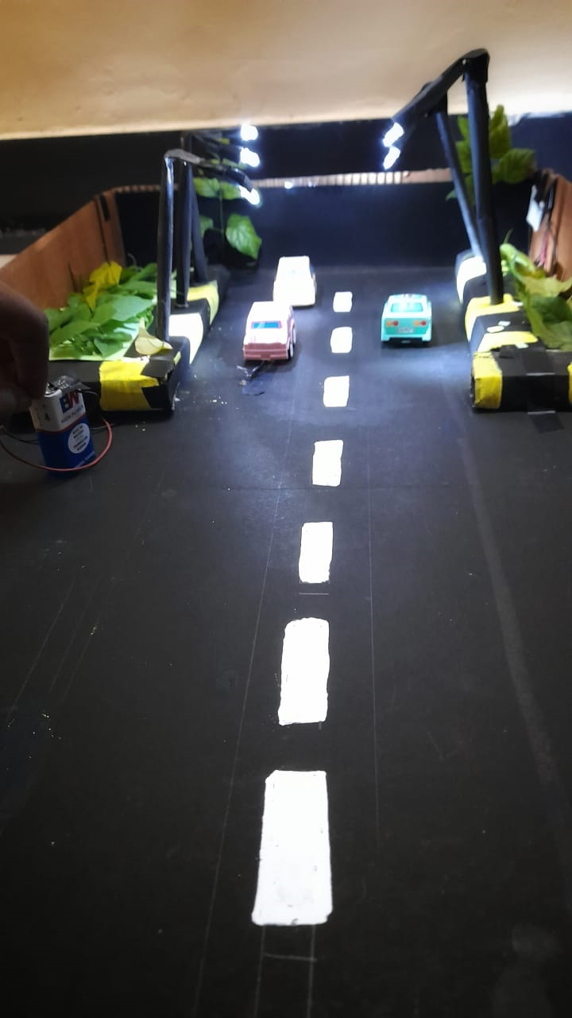

Slide 33




